Slide 1
Eclipse Plug-in Development
Eclipse Plug-in Development Part 3
Actions and Menus

Slide 2
Contents
Overview
Main Menubar
Main Toolbar
View Toolbar
View Pulldown Menu
View/Editor Context Menu
Extension Points
org.eclipse.ui.menus (from 3.3, all supportted)
Deprecated
org.eclipse.ui.ActionSets
org.eclipse.ui.EditorActions
org.eclipse.ui.popupMenus (including 'objectContributions')
org.eclipse.ui.viewActions
Commands and handlers
VisibleWhen

Slide 3
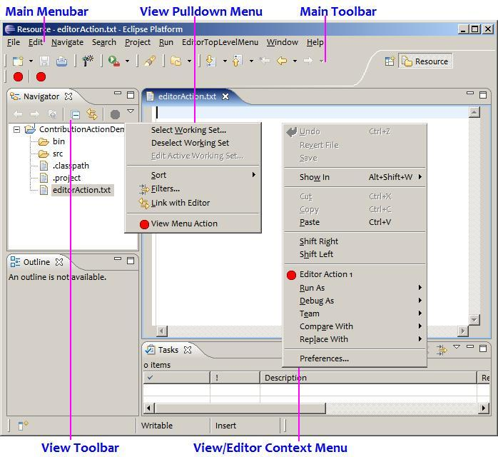
Overview

Slide 4
org.eclipse.ui.menus
menuContribution
locationURI : [Schema]:[id](?[Query])
Schema: menu, popup or toolbar
Id: id of editor/view or an existing menu
Query: <placement>=<id>
placement: before, after or endof
id: id of an existing menu item
class: to provide menu contributions manually, all children will be ignored
allPopups: By default popup contributions are not contributed to context menus that do not include an additions marker.
Where to insert?

Slide 5
org.eclipse.ui.menus
menuContribution
command
org.eclipse.ui.commands
control
org.eclipse.ui.menus.WorkbenchWindowControlContribution
dynamic
org.eclipse.jface.action.ContributionItem
menu
separator
toolbar
What to insert?

Slide 6
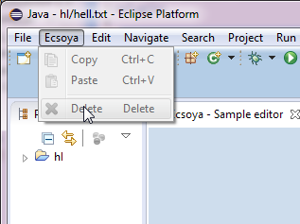
org.eclipse.ui.menus
Main Menubar
<extension
point="org.eclipse.ui.menus">
<menuContribution
locationURI="menu:org.eclipse.ui.main.menu?after=file">
<menu
label="Ecsoya">
<command
commandId="org.eclipse.ui.edit.copy"
style="push">
</command>
<command
commandId="org.eclipse.ui.edit.paste"
style="push">
</command>
<separator
name="edit"
visible="true">
</separator>
<command
commandId="org.eclipse.ui.edit.delete"
style="push">
</command>
</menu>
</menuContribution>
</extension>

Slide 7

org.eclipse.ui.menus
Main Toolbar
<extension
point="org.eclipse.ui.menus">
<menuContribution
allPopups="false"
locationURI="toolbar:org.eclipse.ui.main.toolbar?after=additions">
<toolbar
id="org.ecsoya.eclipse.tutorial.actions.toolbar">
<control
class="org.ecsoya.eclipse.tutorial.actions.SampleToolBarContribution">
</control>
</toolbar>
</menuContribution>
</extension>
public class SampleToolBarContribution extends WorkbenchWindowControlContribution {
public SampleToolBarContribution() {
}
public SampleToolBarContribution(String id) {
super(id);
}
protected Control createControl(Composite parent) {
Combo combo = new Combo(parent, SWT.READ_ONLY);
for (int i = 0; i < 5; i++) {
combo.add("Ecsoya sample item " + i);
}
combo.select(2);
return combo;
}
}

Slide 8
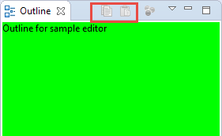
org.eclipse.ui.menus
View Toolbar
<extension
point="org.eclipse.ui.menus">
<menuContribution
allPopups="false"
locationURI="toolbar:org.eclipse.ui.views.ContentOutline">
<command
commandId="org.eclipse.ui.edit.copy"
style="push">
</command>
<command
commandId="org.eclipse.ui.edit.paste"
style="push">
</command>
</menuContribution>
</extension>

Slide 9
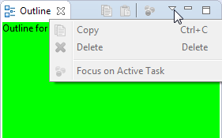
org.eclipse.ui.menus
View Pulldown Menu
<extension
point="org.eclipse.ui.menus">
<menuContribution
allPopups="false"
locationURI="menu:org.eclipse.ui.views.ContentOutline">
<command
commandId="org.eclipse.ui.edit.copy"
style="push">
</command>
<command
commandId="org.eclipse.ui.edit.delete"
style="push">
</command>
</menuContribution>
</extension>

Slide 10
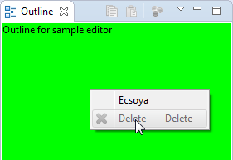
org.eclipse.ui.menus
View Context Menu
<extension
point="org.eclipse.ui.menus">
<menuContribution
allPopups="false"
locationURI="popup:org.ecsoya.eclipse.tutorials.editor.OutlineMenu?after=additions">
<command
commandId="org.eclipse.ui.edit.delete"
style="push">
</command>
</menuContribution>
</extension>
String id = "org.ecsoya.eclipse.tutorials.editor.OutlineMenu";
MenuManager manager = new MenuManager(id);
manager.add(new Action("Ecsoya") {
});
manager.add(new GroupMarker(IWorkbenchActionConstants.MB_ADDITIONS));
Menu menu = manager.createContextMenu(control);
control.setMenu(menu);
getSite().registerContextMenu(id, manager, selectionProvider);
Define menu for View

Slide 11
org.eclipse.ui.menus
Utilities and Constants
org.eclipse.ui.menus.MenuUtils
Workbench menu
Query constants
org.eclipse.ui.IWorkbenchActionConstants
Ids for standard actions
Menu bar group ids
…

Slide 12
Menus Extension Mapping
org.eclipse.ui.actionSets:
Main menu bar and Main toolbar.
The actions are visible when the action set is visible.
org.eclipse.ui.viewActions:
View dropdown menu and View toolbar.
The actions are always visible.
org.eclipse.ui.editorActions:
Main menu bar and Main toolbar.
The actions are visible when the editor of that type is active.
org.eclipse.ui.popupMenus - viewerContribution:
Context menu that matched the specified context id.
The actions are always visible.
org.eclipse.ui.popupMenus - objectContribution:
Any context menu.
The actions are visible when the objectClass and filter criteria are met.
"popup:org.eclipse.ui.menus.popup.any"

Slide 13
org.eclipse.ui.actionSets
<extension
point="org.eclipse.ui.actionSets">
<actionSet
label="Sample Action Set"
visible="true"
id="sample.all.actionSet">
<menu
label="Sample &amp;Menu"
id="sampleMenu">
<separator
name="sampleGroup">
</separator>
</menu>
<action
label="&amp;Sample Action"
icon="icons/sample.gif"
class="sample.all.actions.SampleAction"
tooltip="Hello, Eclipse world"
menubarPath="sampleMenu/sampleGroup"
toolbarPath="sampleGroup"
id="sample.all.actions.SampleAction">
</action>
</actionSet>
</extension>

Slide 14
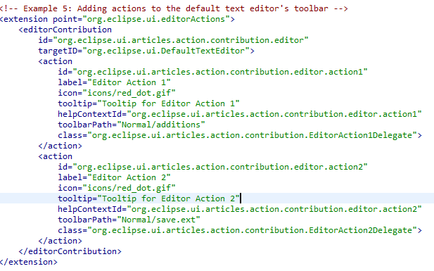
org.eclipse.ui.editorActions

Slide 15
org.eclipse.ui.popupMenus
<extension
point="org.eclipse.ui.popupMenus">
<objectContribution
objectClass="org.eclipse.core.resources.IFile"
id="sample.all.contribution1">
<menu
label="New Submenu"
path="additions"
id="sample.all.menu1">
<separator
name="group1">
</separator>
</menu>
<action
label="New Action"
class="sample.all.popup.actions.NewAction"
menubarPath="sample.all.menu1/group1"
enablesFor="1"
id="sample.all.newAction">
</action>
</objectContribution>
</extension>

Slide 16
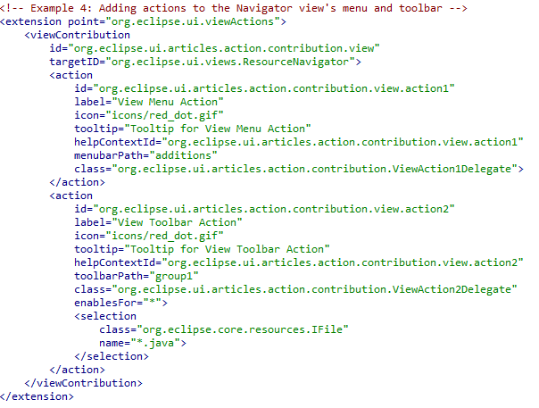
org.eclipse.ui.viewActions

Slide 17
Commands and Handlers
org.eclipse.ui.commands
org.eclipse.ui.handlers
<extension
point="org.eclipse.ui.commands">
<command
defaultHandler="org.ecsoya.eclipse.tutorial.actions.SampleHandler"
id="org.ecsoya.eclipse.tutorial.actions.command"
name="Sample Handler">
</command>
</extension>
<extension
point="org.eclipse.ui.handlers">
<handler
class="org.ecsoya.eclipse.tutorial.actions.SampleHandler"
commandId="org.ecsoya.eclipse.tutorial.actions.command">
</handler>
</extension>

Slide 18
VisibleWhen
org.eclipse.core.expressions.definitions
not
or
and
instanceof
test
systemTest
equals
count
with
resolve
adapt
iterate
reference

Slide 19
Any Questions?
Skype: jin.liu.soyatec
Email: jin.liu@soyatec.com

Slide 20
The end

